Slide 1


Partitioning in Azure Cosmos DB
Will Velida
Software Engineer
Microsoft Data Platform MVP
Notes:
Hello everyone! My name is Will Velida, I’m a Software Engineer and Microsoft Data Platform MVP based in Auckland, New Zealand and in this video we’re going to be talking about Partitioning in Azure Cosmos DB

Slide 2
Where are we?
Modelling our data
Understanding Partitioning
Understanding Throughput
Database and Container Design
Understanding Global Distribution
Notes:
So in my last video we talked about modelling our data. This is the first step on the journey to achieving scalability in Azure Cosmos DB.
In that video, I talked about the idea of storing different document types (that is different data models) within the same container and how this is possible by ensuring that we model our data as such so that these different document types can sit within the same partition key, so that conversation leads us quite nicely into this video, which will help us understand how partitioning works in Cosmos DB

Slide 3
What we’re going to discuss
How partitioning works in Cosmos DB.
Managing Partitions in Cosmos DB.
Choosing a Partition Key.
Querying items within a Partition.
Performing Cross-Partition Queries.
Notes:
First off, we’ll discuss at a high level how partitioning works in Cosmos DB and how we can manage partitions as users, as well as how Cosmos DB manages partitions under the hood.
We’ll then talk about how to choose a partition key for our Collections in Cosmos DB depending on what kind of operations we are going to perform on our containers.
Then we’ll go through some practical examples of querying our data within a partition that we choose for our containers. We’ll also talk about querying data across partitions via Cross-Partition queries. This is entirely possible, but there are some things to consider when performing Cross-Partition queries which we’ll discuss.

Slide 4
How Partitioning Works
Cosmos DB uses partitioning to scale containers to meet performance needs.
Items in our containers are divided into logical partitions.
These are based on the value of a partition key that is associated with items in our containers.
All items in a logical partition have the same partition key value
These logical partitions are then mapped to physical partitions behind the scenes.
Notes:
So how does Partitioning work in Cosmos DB?
Partitioning is used to scale individual containers in a database to meet the needs of our applications.
Every time we persist an item into our containers, they are divided into something called logical partitions. These are based on the value of a partition key that is associated with an item that we store in our containers.
Items within a logical partition will all have the same partition key value. This will be a property within our documents, so for example, if I had a container that was storing items related to hotels, and we gave that container a partition key of CityName and we had 20 different CityName values in our container, we would have 20 logical partitions created for that container.
These logical partitions are then mapped to physical partitions. These are a internal implementation of the partitioning system and they are managed by the Cosmos DB team. Just for your information, Physical partitions just essentially are a fixed amount of reserved SSD-backed storage and compute. Let’s illustrate this with an example.

Slide 5
Partition Key Value:
/CityName
10K RU
50GB
Auckland
Sydney
New York
London
Dublin
Seattle
Redmond
Paris
Partition 1
Partition 2
Partition n
Notes:
So in this example, let’s say we have a container containing hotels that’s partitioned by CityName, so every time we add a document to our hotel container that has a CityName value of Auckland, it would be placed inside that logical partition, and let’s say we add a bunch of documents and each time new logical partitions are created. These will then be mapped to Physical Partitions.
One or more logical partitions can be mapped to a single physical partition, so we have our logical partitions for Auckland, London, Redmond and Paris all placed inside our Physical partition here. Now depending on the size of these logical partitions, we may only require a single physical partition. Remember we don’t manage these physical partitions. The Cosmos DB team does that. But we do need to consider a couple of things that physical partitions depend on.
The amount of throughput that we provision on our containers. Each physical partition can provide a maximum of 10,000 RU’s. I’ve been in situations where we’ve cracked up our RU amount to 1,000,000 and this doesn’t work due to the limitation on the physical partitions.
The amount of storage. So each physical partition can store up to 50GB of data
Now there is no limit to the amount of physical partitions that our containers have. As our data grows and the amount of throughput we provision grows, Cosmos DB will automatically create new partitions by splitting existing ones without affecting your application’s availability.
When our physical partitions split, the data in a logical partition will still remain within the same physical partition. All that happens with the split in physical partitions is a new mapping of the logical partitions to physical ones.
Throughput that is provisioned on a container will be divided evenly among our physical partition. In terms of partition design, it’s important that we get this right to prevent something called ‘hot’ partitions.

Slide 6
Hot Partitions
Storage or Throughput threshold
Paris
London
Auckland
Redmond
Dublin
Notes:
Hot partitions occur within our Cosmos DB containers when our partition key doesn’t distribute the amount of throughput or storage efficiently. This results in rate-limiting and inefficient use of throughput, which in turn leads to higher costs.
So let’s use our Hotel container example again, say if we have a bunch of documents that belong to different cities and they look fairly evenly distributed. But then we have lots of documents that have a CityName partition value of Paris. It looks like there’s a lot of them and almost exceeding the threshold in terms of storage or throughput. This partition is what we would call a Hot partition.
If this was our application, we would have to reconsider using CityName as our partition key, as it’s important that our partition key evenly distributes throughput consumption and storage.
With this in mind, let’s talk about how we can prevent this with good partition key design.

Slide 7
Partition Key Components
Partition Key Path /CityName
Partition Key Value Auckland
Notes:
Partition keys have two components. The path and the value. Using our hotel example from before, we can see that the Partition Key path is CityName. Partition Key Paths in Cosmos DB accepts alphanumeric and underscore characters and you can even set a partition key path on nested objects using path notation.
The partition key value, is the value of our property. So in this example, Auckland would be the value of the Partition Key. This value can be string or numeric types.
Selecting partition key is simple, but it’s critical to get this choice right. In Cosmos DB, once we’ve selected a partition key, it’s not possible to change it. If you do need to change it, you’ll have to create a new container with your new partition key and then migrate it from the old container to the new one. Trust me, that’s a heck of a process, so my recommendation here is that you spend a bit of time thinking about how you’re going to partition your data.

Slide 8
Good Partition Keys have
A value that does not change.
A wide range of values.
Spread Throughput and Storage evenly across logical partitions.
Notes:
Good partition keys will have properties with values that do not change. One you’ve committed your item with a partition value, we can’t then update this value.
They should also have a wide range of values to ensure even distribution across logical partitions in terms of throughput and storage.
This in turn will ensure even throughput consumption and storage distribution across our physical parition

Slide 9
Workload Considerations
Pick a partition key value that appears frequently as a filter.
Use item id to ensure cardinality of partition keys.
Notes:
Our choice for our partition key will depend on the workload that our containers will be performing.
For read-heavy containers, we may wish to choose a partition key property that appears frequently as a filter in the queries that we perform. If we are querying frequently on a certain property, this could be a good choice for our partition key.
For write heavy containers, we may want to use the id of a document as our partition key value. ID is guaranteed to exist in every item in our Cosmos DB containers, this item id has to be unique, so this can help us achieve even distribution in terms of throughput and storage. If we have to query our items and we know this item id when querying it, this is great for performing efficient point reads

Slide 10
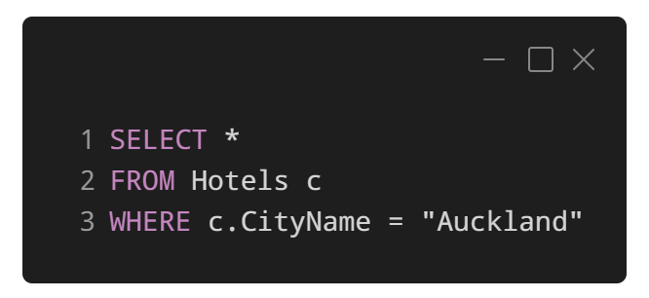
In-Partition Queries
Container partitioned on ‘CityName’.
Queries will filter to single physical partition.
Adding additional filters to don’t change this.
Performing range filters on PK are not scoped to a single Physical Partition.
Notes:
We can help Cosmos DB optimize our queries by specifying our partition key as a filter. So in this example, we have our hotel container partitioned on CityName. What Cosmos DB will do under the hood is route this query to the physical partition that this partition key value is mapped to.
Now what’s great about this is if we added additional filters to this query, it would still filter to a single partition. Adding additional filters doesn’t change this.
However, say if we partitioned our hotel container by say a Star Rating property and we wanted to query our container to return all the hotels with a Star rating greater than 4, then this query wouldn’t not be scoped to a single physical partition. This will cause our query to be executed across partitions, or what is otherwise referred to as a cross partition query.

Slide 11
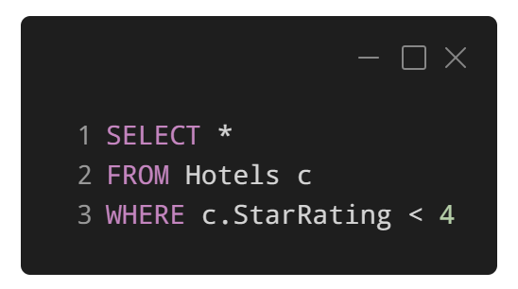
Cross-Partition Queries
Queries that don’t filter on partition keys
Queries must fan-out to all physical partitions.
Effectively run the query against each physical partition.
Must wait for each query to finish before getting result.
Notes:
If we query without using our partition key as a filter, like we’ve done here, the query will fan-out to all physical partitions, where it will be run against each partitions index.
Each physical partition will have its own index, so when we run a cross-partition query on a container, we are running one query per physical partition. What Cosmos DB will do is aggregate the results across different partitions and will cause a bottleneck, since we must wait for all physical partitions to return the results of the query before the query is done.

Slide 12



Query-Fan Out
Notes:
So to visualize this, here we’re performing a query to retrieve all the hotels in our container with a Star rating less than 4. Our container is still partitioned by CityName, so we are performing a cross partition query.
We execute this query and since it won’t be routed to a specific partition, we will have to wait for the query to be finished on all physical partitions before getting the result back to us.

Slide 13
Should we avoid Cross-Partition Queries?
Not entirely! Some are ok ☺
Highly likely we will have to do X-Partition Queries.
Can optimize X-Partition queries using client SDKs.
Should avoid with large containers.
Notes:
Now you might be thinking in terms of performance and throughput cost, we should avoid cross partition queries all together.
This isn’t entirely true. In fact, it’s highly likely that we will have to perform cross-parititon queries from time to time. We do have a couple of options to make cross partition queries more efficient thanks to the client SDKs that the Cosmos DB team have developed.
We should however, look to avoid performing cross partition queries with large containers. Every time we check a physical partition’s index, we are charge at a minimum 2.5 Request Units (I know we haven’t taken a proper look at throughput yet, but depending on how many items are stored within a physical partition, this can get expensive) We are charged this even if there are no items in that physical partition that fulfil our queries filter criteria.

Slide 14
Partitioning Demo
Notes:
Alright, let’s head into the Azure Portal and see Partitioning in action.

Slide 15
What next?
Modelling our data
Understanding Partitioning
Understanding Throughput
Database and Container Design
Understanding Global Distribution
Notes:
So after watching this video, I hope you have a greater understanding of what partitioning in Cosmos DB is and how it works.
So far we have talked about Data Modelling and Partitioning and these concepts are the foundation of ensuring that our applications can scale. We’re now ready to talk about Throughput and how we can provision enough Throughput to meet the workload demands of our application. This is also important because we are charged money for Throughput, so I recommend you definitely tune in to watch that video!

Slide 16
Thanks for Listening
@willvelida
https://www.linkedin.com/in/willvelida/
Notes:
Thanks for listening! As always, if you have any questions, please feel free to ask me in the comments or reach out to me on Twitter or LinkedIn. See you next time.

